Slide 1
Features in Computer Vision Part-1
Feature Detectors and Descriptors
Computer Vision, 6th Semester, 2024

Slide 2
Features in Computer Vision
A specific, measurable, and distinctive property or characteristic of an image or a part of an image
Essential for representing and describing the visual content of an image
Enables computer vision algorithms to analyze and recognize patterns

Slide 3
Requirement of Features in computer Vision
DIMENSIONALITY REDUCTION:
Raw pixel data - high-dimensional; lot of redundant information.
Features capture essential information and ignore irrelevant details.
DISCRIMINATIVE INFORMATION:
Features highlight distinctive and discriminative aspects of the visual content
Emphasis on unique characteristics to differentiate objects/patterns
ABSTRACTION:
Features represent complex visual information in a compact meaningful form, allowing algorithms to focus on relevant patterns and structures in the data.
ROBUSTNESS:
Focus on properties less sensitive to environmental changes,
Features enhance the robustness of computer vision algorithms to variations in lighting conditions, orientation, and other factors
COMPUTATIONAL EFFICIENCY:
Working directly with raw pixel values can be computationally expensive.
Extracting relevant features enables more efficient processing
TASK-SPECIFIC INFORMATION:
Features can be tailored to the specific requirements of tasks, ensuring to provide task-relevant information.
INTERPRETABILITY:
Extracted features often have semantic meanings
Crucial where decision-making needs to be transparent and explainable

Slide 4
Feature Detectors

Slide 5
Concept
Algorithms or methods designed to identify specific patterns or features within images.
Simple features: edges or corners
Complex features: textures or shapes.
Feature detection is a crucial step in various computer vision tasks:
object recognition
image segmentation
motion analysis

Slide 6
Common Feature Detectors
Edge Detectors:
Detects boundaries in an image where the intensity changes abruptly.
E.g. Sobel operator, Prewitt operator, Canny edge detector.
Corner Detectors:
Identify corners or points in an image where the intensity gradients change in multiple directions.
E.g. Harris corner detector, Shi-Tomasi corner detector
Blob or Region Detectors:
Focus on identifying regions or blobs with homogeneous intensity or color.
E.g. Laplacian of Gaussian (LoG), Difference of Gaussians (DoG)
Line Detectors:
Detect straight lines in images, often used in applications like image stitching.
E.g. Hough Transform

Slide 7
Common Feature Detectors
Scale-Invariant Feature Transform (SIFT):
Identifies key points in an image that are invariant to scale, rotation, and illumination changes.
Speeded-Up Robust Features (SURF):
Similar to SIFT but designed to be computationally more efficient.
Binary Robust Invariant Scalable Keypoints (BRISK):
Focuses on binary descriptors for efficient feature matching.
Deep Learning-based Feature Detectors:
Convolutional neural networks (CNNs) are used to automatically learn hierarchical features from data.

Slide 8
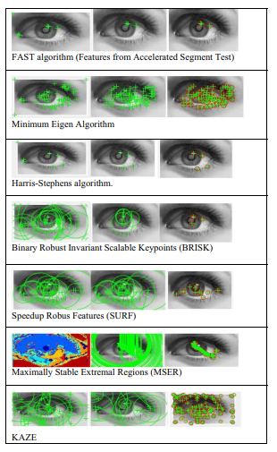
Features Detected on a sample image
Courtesy:
Gino Sophia, S.G., Ceronmani Sharmila, V. Computer vision algorithms for dominant contact lens feature extraction using fuzzy-logic-based classifications. Soft Comput 24, 14235–14249 (2020). https://doi.org/10.1007/s00500-020-04791-1

Slide 9
Feature Descriptors

Slide 10
Concept
Descriptors encode information about distinct and repeatable local features in an image,
The information makes it possible for computer vision algorithms to understand and compare different parts of images.
Key points:
Local feature detection
Local feature description
Invariance and Robustness
Utility in feature matching and recognition

Slide 11
Common Feature Descriptors
SIFT (Scale-Invariant Feature Transform):
Invariant to scale and rotation
Describes local gradient information in a region around a key point.
SURF (Speeded-Up Robust Features):
Similar to SIFT but designed to be computationally more efficient.
ORB (Oriented FAST and Rotated BRIEF):
Combination of the FAST keypoint detector and the BRIEF descriptor
Designed to be fast and efficient.
KAZE and AKAZE (Accelerated KAZE) [kaze: ‘wind’ in Japanese]
Effective in scenarios with significant viewpoint changes and illumination variations
Utilize nonlinear scale spaces and differential geometry
Histogram of Oriented Gradients (HOG)
Quantify the local gradient information in an image
Section the image into small regions and computing histograms of gradient orientations in the regions

Slide 12
Common Feature Descriptors
Binary Descriptors:
Binary descriptors, such as
BRIEF (Binary Robust Independent Elementary Features)
BRISK (Binary Robust Invariant Scalable Keypoints)
LBP (Local Binary Patterns)
Represent features using binary codes.
Faster to compute and require less memory compared to non-binary descriptors.
Deep Learning-based Descriptors:
Approaches that use neural networks to learn feature representations directly from images
Bypassing the need for handcrafted descriptors

Slide 13
Common Feature Descriptors
Shape Matrices
Encapsulate geometric information for understanding object structures
Often derived from contours or boundaries
Characteristics such as size, orientation, and aspect ratio
Invariant Moments
Representation of object shapes unaffected by translation, rotation, or scale changes
Capture distinctive spatial relationships within an image
First-order Statistical Features
Overall intensity distribution within an image
Fundamental descriptors highlighting global characteristics
Second-order Texture Features
Spatial relationships between pixel intensities
Capturing patterns and variations through methods like co-occurrence matrices
Richer understanding of texture characteristics in an image
Histogram Features
Distribution of pixel intensities within an image
Extraction of statistical information

Slide 14
Types of Feature Descriptors
Local Descriptors
Global Descriptors
SIFT
SURF
KAZE, AKAZE
ORB
HOG
Binary Descriptors
Deep Feature Descriptors
Shape Matrices
Invariant Moments
First Order Statistical Features
Second Order Texture Features
Histogram Features

Slide 15
Difference between detectors and descriptors
Type | Feature Detector | Feature Descriptor
Function | Identify specific distinctive or interesting points or regions (keypoints) in an image | Provide a quantitative representation of local image information around the keypoints
Output | Set of keypoints representing distinctive parts of an image | Vectors representing characteristics of the image around each keypoint
Computational Complexity | Lower than descriptors | Higher than detectors
Use cases | Object recognition, image stitching, object tracking | Image matching, object recognition, 3D reconstruction, image classification
Examples | Harris corner detector, FAST, SIFT, SURF, ORB | SIFT descriptor, SURF descriptor, BRIEF descriptor, HOG, LBP

Slide 16
Feature extraction methods – a listing
Method | Detector or Descriptor or Both | Year proposed
SIFT | Both | 1999
FAST | Detector | 2006
SURF | Both | 2006
BRIEF | Descriptor | 2010
BRISK | Both | 2011
ORB | Both | 2011
Kaze | Both | 2012
A-Kaze (Accelerated Kaze) | Both | 2013
MSD (Maximal Self-Dissimilarity) | Detector | 2014

Slide 17
Selected Techniques of Feature Detection and Description

Slide 18
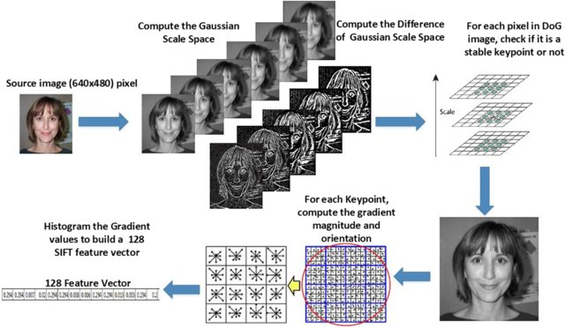
SIFT (Scale-Invariant Feature Transform)
Generate a scale-space pyramid (convolve input image with Gaussian filters at different scales)
Keypoints: local extrema in the scale-space pyramid.
Refine the location of keypoints.
Reject keypoints with low contrast or poorly localized along edges.
Compute gradient magnitude and orientation for each pixel in keypoint vicinity.
Create a histogram of gradient orientations.
Assign dominant orientation to keypoint.
Define a local region around the keypoint.
Divide the region into sub-regions.
For each sub-region, compute a histogram of gradient orientations.
Concatenate all histograms to form a feature vector for the keypoint.
Normalize the keypoint size based on its scale.
Rotate the keypoint descriptor based on the assigned orientation.

Slide 19
SURF (Speeded-Up Robust Features) – process
Compute the Hessian matrix H for the image to identify regions with significant intensity variations.
Candidate keypoints: det(H) is a local extrema
Compute Haar wavelet responses in horizontal and vertical directions around the point.
Construct a response vector by combining the responses.
Create a weighted orientation histogram from the responses.
Assign the dominant orientation to the keypoint.
Define a square region around the point and divide it into sub-regions.
Calculate Haar wavelet responses for each sub-region.
Concatenate the responses from all sub-regions into a descriptor vector.
Normalize the descriptor vector to ensure invariance to changes in illumination.
Normalize the descriptor based on the scale computed during keypoint detection.
Final SURF vector for a keypoint = location + orientation + normalized descriptor vector.

Slide 20
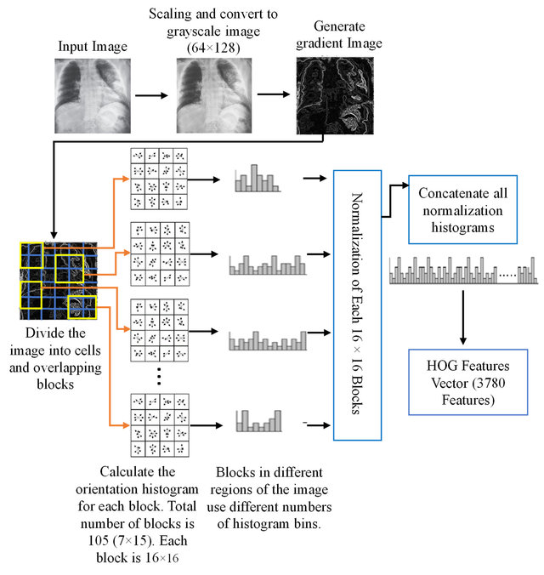
HOG (Histogram of Oriented Gradients)
Calculate horizontal and vertical gradients of the image using filter convolution.
Compute the magnitude and orientation of the gradients at each pixel.
Divide the image into non-overlapping cells of a predefined size.
For each cell:
Create a histogram of gradient orientations within the cell as stated above.
Bin the gradient orientations into predefined angular bins (e.g., 9 bins).
Group adjacent cells into blocks.
Normalize the histograms within each block to enhance local contrast and reduce the effects of illumination variations.
Concatenate the normalized histograms from all blocks to form the HOG feature vector for the entire image.
Optionally, normalize the entire HOG feature vector to make it invariant to changes in overall intensity.

Slide 21
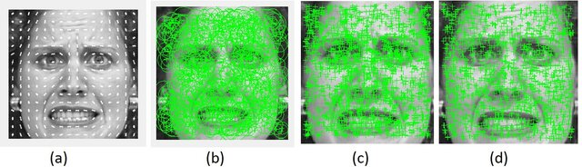
Illustration of Feature Extraction methods
HOG patterns
SURF keypoints
FAST keypoints
Harris keypoints

Slide 22
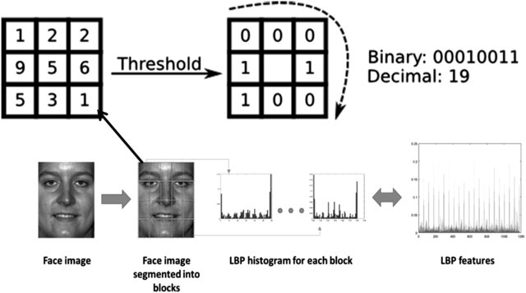
LBP (Local Binary Patterns)
Convert the input color image to grayscale if it is not already in that format.
For each pixel in the image, define a circular or square neighborhood around it.
Compare the intensity value of the center pixel I(x) with the intensity values of its neighbors I(neighbor(x)) in the defined neighborhood.
Assign a binary value of 1 if I(neighbor(x)) >= I(x); otherwise, assign 0.
Optionally, rotate the generated binary pattern to obtain a canonical representation.
Convert the binary pattern number to its decimal equivalent.
Repeat steps 2-6 for every pixel in the image to create a Local Binary Pattern for each pixel.
Construct a histogram of the generated LBP values
Optionally, use the LBP histogram as a feature descriptor.

Slide 23
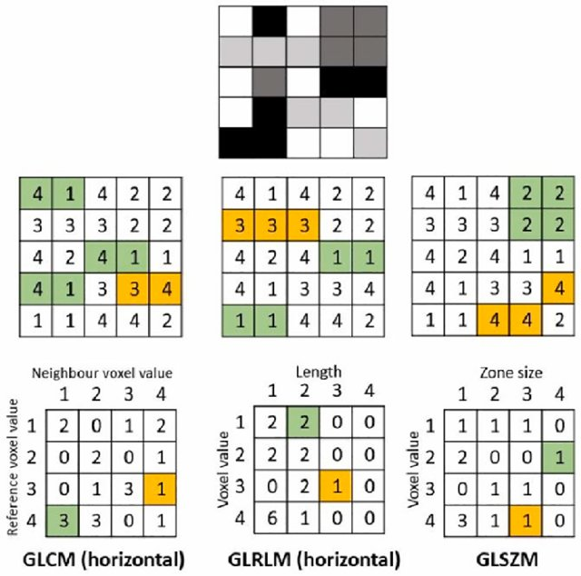
Some Pixel Relationship Matrices
Gray-level Co-occurrence Matrix (GLCM):
2nd-order pixel distribution function.
GLCM(i, j, d, t) = no. of times pixel value i occurs near j at distance d and angle t.
Gray-level Run Length Matrix (GLRLM):
Quantifies gray-level runs (lengths of pixels of same value)
GLRLM(i, j, t) = no. of runs of pixel value i of length j along angle t.
Gray-level Size Zone Matrix (GLSZM):
Quantifies various pixel-based zones in the image.
Zone: a set of connected pixels with same gray intensity.
Rotation/angle independent feature
Z(i, j) = no. of zones of pixel value i of size j (no. of pixels = j)
Neighboring Gray-level Dependency Matrix (NGLDM)
Neighboring Gray Tone Difference Matrix (NGTDM)

Slide 24
Further Reading
Sharma SK, Jain K, Shukla AK. A Comparative Analysis of Feature Detectors and Descriptors for Image Stitching. Applied Sciences. 2023; 13(10):6015. https://doi.org/10.3390/app13106015
https://www.mdpi.com/2076-3417/13/10/6015

